Slide 1
PL/SQL:
concept of Stored Procedures &
Functions, Cursors, Triggers,
Assertions, roles and privileges , Embedded SQL, Dynamic SQL

Slide 2
PL/SQL
PL/SQL (Procedural Language/Structured Query Language) is Oracle Corporation's procedural extension for SQL and the Oracle relational database. PL/SQL is available in Oracle Database.
PL/SQL is a combination of SQL along with the procedural features of programming languages.
It was developed by Oracle Corporation in the early 90's to enhance the capabilities of SQL.
PL/SQL is one of three key programming languages embedded in the Oracle Database, along with SQL itself and Java.

Slide 3
PL/SQL includes procedural language elements such as conditions and loops. It allows declaration of constants and variables, procedures and functions.
It can handle exceptions (runtime errors). Arrays are supported involving the use of PL/SQL collections.
Implementations from version 8 of Oracle Database onwards have included features associated with object-orientation. One can create PL/SQL units such as procedures, functions, packages, types, and triggers, which are stored in the database.

Slide 4
Feaures of PL/SQL −
PL/SQL is a completely portable, high-performance transaction-processing language.
PL/SQL provides a built-in, interpreted and OS independent programming environment.
PL/SQL can also directly be called from the command-line SQL*Plus interface.
PL/SQL's general syntax is based on that of ADA and Pascal programming language.
PL/SQL is tightly integrated with SQL.
It offers extensive error checking.
It offers numerous data types.

Slide 5
It offers a variety of programming structures.
It supports structured programming through functions and procedures.
It supports object-oriented programming.
It supports the development of web applications and server pages.

Slide 6
What is PL/SQL?
PL/SQL basically stands for "Procedural Language extensions to SQL".
This is the extension of Structured Query Language (SQL) that is used in Oracle. PL/SQL allows the programmer to write code in procedural format.
It combines the data manipulation power of SQL with the processing power of procedural language to create a super powerful SQL queries.
It allows the programmers to instruct the compiler 'what to do' through SQL and 'how to do' through its procedural way.
Similar to other database languages, it gives more control to the programmers by the use of loops, conditions and object oriented concepts.

Slide 7
Architecture of PL/SQL
The PL/SQL architecture mainly consists of following 3 components:
PL/SQL block
PL/SQL Engine
Database Server

Slide 8
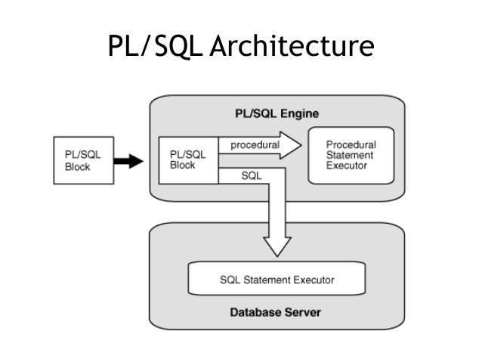

Slide 9
PL/SQL block
This is the component which has the actual PL/SQL code.
This consists of different sections to divide the code logically (declarative section for declaring purpose, execution section for processing statements, exception handling section for handling errors)
It also contains the SQL instruction that used to interact with the database server.
All the PL/SQL units are treated as PL/SQL blocks, and this is the starting stage of the architecture which serves as the primary input.
Following are the different type of PL/SQL units.
Anonymous Block
Function
Library
Procedure
Package Body
Package Specification
Trigger
Type
Type Body

Slide 10
PL/SQL Engine
PL/SQL engine is the component where the actual processing of the codes takes place.
PL/SQL engine separates PL/SQL units and SQL part in the input.
The separated PL/SQL units will be handled with the PL/SQL engine itself.
The SQL part will be sent to database server where the actual interaction with database takes place.
It can be installed in both database server and in the application server.

Slide 11
Database Server
This is the most important component of PL/SQL unit which stores the data.
The PL/SQL engine uses the SQL from PL/SQL units to interact with the database server.
It consists of SQL executor which actually parses the input SQL statements and execute the same.

Slide 12
Basic Difference between SQL and PL/SQL
SQL | PL/SQL
SQL is a single query that is used to perform DML and DDL operations. | PL/SQL is a block of codes that used to write the entire program blocks/ procedure/ function, etc.
It is declarative, that defines what needs to be done, rather than how things need to be done. | PL/SQL is procedural that defines how the things needs to be done.
Execute as a single statement. | Execute as a whole block.
Mainly used to manipulate data. | Mainly used to create an application.
Interaction with Database server. | No interaction with the database server.
Cannot contain PL/SQL code in it. | It is an extension of SQL, so it can contain SQL inside it.

Slide 13
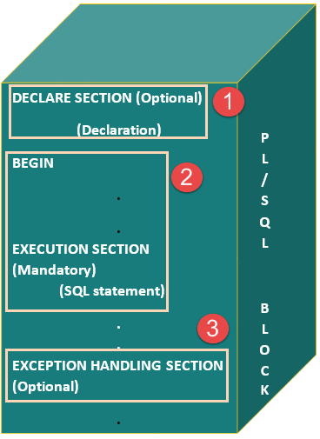
Basic Syntax of PL/SQL which is a block-structured language; this means that the PL/SQL programs are divided and written in logical blocks of code. Each block consists of three sub-parts −

Slide 14
S.No | Sections & Description
1 | Declarations This section starts with the keyword DECLARE. It is an optional section and defines all variables, cursors, subprograms, and other elements to be used in the program.
2 | Executable Commands This section is enclosed between the keywords BEGIN and END and it is a mandatory section. It consists of the executable PL/SQL statements of the program. It should have at least one executable line of code, which may be just a NULL command to indicate that nothing should be executed.
3 | Exception Handling This section starts with the keyword EXCEPTION. This optional section contains exception(s) that handle errors in the program.

Slide 15
Declaration Section
This is the first section of the PL/SQL blocks.
This is the section in which the declaration of variables, cursors, exceptions, subprograms, pragma instructions and collections that are needed in the block will be declared.
This particular section is optional and can be skipped if no declarations are needed.
This should be the first section in a PL/SQL block, if present.
This section should be always followed by execution section.
This section starts with the keyword ‘DECLARE’.

Slide 16
Execution Section
Execution part is the main and mandatory part which actually executes the code that is written inside it.
Since the PL/SQL expects the executable statements from this block this cannot be an empty block, i.e., it should have at least one valid executable code line in it.
This can contain both PL/SQL code and SQL code.
This can contain one or many blocks inside it as a nested blocks.
This section starts with the keyword 'BEGIN'.
This section should be followed either by 'END' or Exception-Handling section (if present)

Slide 17
Exception-Handling Section:
The exception are unavoidable in the program which occurs at run-time and to handle this Oracle has provided an Exception-handling section in blocks. This section can also contain PL/SQL statements. This is an optional section of the PL/SQL blocks.
This is the section where the exception raised in the execution block is handled.
This section is the last part of the PL/SQL block.
Control from this section can never return to the execution block.
This section starts with the keyword 'EXCEPTION'.
This section should be always followed by the keyword 'END'.
The Keyword 'END' marks the end of PL/SQL block.

Slide 18
Every PL/SQL statement ends with a semicolon (;). PL/SQL blocks can be nested within other PL/SQL blocks using BEGIN and END.
Following is the basic structure of a PL/SQL block −
DECLARE
<declarations section>
BEGIN
<executable command(s)>
EXCEPTION
<exception handling>
END;

Slide 19
The 'Hello World' Example
DECLARE
message varchar2(20):= 'Hello, World!';
BEGIN
dbms_output.put_line(message);
END;
/
The END; line signals the end of the PL/SQL block. To run the code from the SQL command line, you may need to type / at the beginning of the first blank line after the last line of the code.
When the above code is executed at the SQL prompt, it produces the following result −
Hello World
PL/SQL procedure successfully completed.

Slide 20
Advantages of PL/SQL
SQL is the standard database language and PL/SQL is strongly integrated with SQL.
PL/SQL supports both static and dynamic SQL.
Static SQL supports DML operations and transaction control from PL/SQL block.
In Dynamic SQL, SQL allows embedding DDL statements in PL/SQL blocks.
PL/SQL allows sending an entire block of statements to the database at one time. This reduces network traffic and provides high performance for the applications.
PL/SQL gives high productivity to programmers as it can query, transform, and update data in a database.

Slide 21
PL/SQL saves time on design and debugging by strong features, such as exception handling, encapsulation, data hiding, and object-oriented data types.
Applications written in PL/SQL are fully portable.
PL/SQL provides high security level.
PL/SQL provides access to predefined SQL packages.
PL/SQL provides support for Object-Oriented Programming.
PL/SQL provides support for developing Web Applications and Server Pages.

Slide 22
The PL/SQL Identifiers
PL/SQL identifiers are constants, variables, exceptions, procedures, cursors, and reserved words.
The identifiers consist of a letter optionally followed by more letters, numerals, dollar signs, underscores, and number signs and should not exceed 30 characters.
By default, identifiers are not case-sensitive. So you can use integer or INTEGER to represent a numeric value. You cannot use a reserved keyword as an identifier.

Slide 23
The PL/SQL Comments
Program comments are explanatory statements that can be included in the PL/SQL code that you write and helps anyone reading its source code.
All programming languages allow some form of comments.
The PL/SQL supports single-line and multi-line comments.
All characters available inside any comment are ignored by the PL/SQL compiler.
The PL/SQL single-line comments start with the delimiter -- (double hyphen) and multi-line comments are enclosed by /* and */.

Slide 24
DECLARE -- variable declaration .
message varchar2(20):= 'Hello, World!';
BEGIN
/* * PL/SQL executable statement(s) */ dbms_output.put_line(message);
END;
/
Output:-
Hello World
PL/SQL procedure successfully completed.

Slide 25
PL/SQL - Data Types
CHARACTER Data type
NUMBER Data type
BOOLEAN Data type
DATE Data type
LOB Data type

Slide 26
PL/SQL - Data Types
S.No | Category & Description
1 | Scalar Single values with no internal components, such as a NUMBER, DATE, or BOOLEAN.
2 | Large Object (LOB) Pointers to large objects that are stored separately from other data items, such as text, graphic images, video clips, and sound waveforms.
3 | Composite Data items that have internal components that can be accessed individually. For example, collections and records.
4 | Reference Pointers to other data items.

Slide 27
PL/SQL Large Object (LOB) Data Types Large Object (LOB) data types refer to large data items such as text, graphic images, video clips,and sound waveforms. LOB data types allow efficient, random, access to this data.
Data Type | Description | Size
BFILE | Used to store large binary objects in operating system files outside the database. | System-dependent. Cannot exceed 4 gigabytes (GB).
BLOB | Used to store large binary objects in the database. | 8 to 128 terabytes (TB)
CLOB | Used to store large blocks of character data in the database. | 8 to 128 TB
NCLOB | Used to store large blocks of NCHAR data in the database. | 8 to 128 TB

Slide 28
Database character set is used for identifiers such as table names, column names, and PL/SQL variables.
It is also used for data stored in CHAR, VARCHAR2, CLOB, and LONG columns and SQL and PL/SQL program source.
National character set is used for data stored in NCHAR, NVARCHAR2, and NCLOB columns.
Varying-width multi-byte character set can be used as a national character set or a database character set.
A fixed-width multi-byte character set, on the other hand, can be used for a national character set but not a database character set.
So if you need to use fixed-width multi-byte character set you must use it as national character set and find matching varying-width multi-byte character set for database character set.

Slide 29
PL/SQL - Variables
The name of a PL/SQL variable consists of a letter optionally followed by more letters, numerals, dollar signs, underscores, and number signs and should not exceed 30 characters.
By default, variable names are not case-sensitive. You cannot use a reserved PL/SQL keyword as a variable name.
PL/SQL programming language allows to define various types of variables, such as date time data types, records, collections, etc

Slide 30
Variable Declaration in PL/SQL
PL/SQL variables must be declared in the declaration section or in a package as a global variable. When you declare a variable, PL/SQL allocates memory for the variable's value and the storage location is identified by the variable name.
The syntax for declaring a variable is −
variable_name [CONSTANT] datatype [NOT NULL] [:= | DEFAULT initial_value]
Where, variable_name is a valid identifier in PL/SQL, datatype must be a valid PL/SQL data type.

Slide 31
Some valid variable declarations along with their definition are shown below −
sales number(10, 2);
pi CONSTANT double precision := 3.1415;
name varchar2(25);
address varchar2(100);

Slide 32
When you provide a size, scale or precision limit with the data type, it is called a constrained declaration.
Constrained declarations require less memory than unconstrained declarations.
For example −
sales number(10, 2);
name varchar2(25);
address varchar2(100);

Slide 33
Initializing Variables in PL/SQL
Whenever you declare a variable, PL/SQL assigns it a default value of NULL.
If you want to initialize a variable with a value other than the NULL value, you can do so during the declaration, using either of the following −
The DEFAULT keyword
The assignment operator
For example −
counter binary_integer := 0;
greetings varchar2(20) DEFAULT 'Have a Good Day';

Slide 34
You can also specify that a variable should not have a NULL value using the NOT NULL constraint.
If you use the NOT NULL constraint, you must explicitly assign an initial value for that variable.
It is a good programming practice to initialize variables properly otherwise, sometimes programs would produce unexpected results.

Slide 35
DECLARE
a integer := 10;
b integer := 20;
c integer;
f real;
BEGIN
c := a + b;
dbms_output.put_line('Value of c: ' || c);
f := 70.0/3.0;
dbms_output.put_line('Value of f: ' || f);
END;
/

Slide 36
Output
Value of c: 30
Value of f: 23.433333333333333333
PL/SQL procedure successfully completed.

Slide 37
Variable Scope in PL/SQL
PL/SQL allows the nesting of blocks, i.e., each program block may contain another inner block. If a variable is declared within an inner block, it is not accessible to the outer block.
However, if a variable is declared and accessible to an outer block, it is also accessible to all nested inner blocks.
There are two types of variable scope −
Local variables − Variables declared in an inner block and not accessible to outer blocks.
Global variables − Variables declared in the outermost block or a package.

Slide 38
DECLARE
-- Global variables
num1 number := 95;
num2 number := 85;
BEGIN
dbms_output.put_line('Outer Variable num1: ' || num1);
dbms_output.put_line('Outer Variable num2: ' || num2);
DECLARE
-- Local variables
num1 number := 195;
num2 number := 185;
BEGIN
dbms_output.put_line('Inner Variable num1: ' || num1);
dbms_output.put_line('Inner Variable num2: ' || num2);
END;
END;
/

Slide 39
Output
Outer Variable num1: 95
Outer Variable num2: 85
Inner Variable num1: 195
Inner Variable num2: 185
PL/SQL procedure successfully completed.

Slide 40
PL/SQL Records
What are records?
Records are another type of datatypes which oracle allows to be defined as a placeholder.
Records are composite datatypes, which means it is a combination of different scalar datatypes like char, varchar, number etc.
Each scalar data types in the record holds a value. A record can be visualized as a row of data. It can contain all the contents of a row.

Slide 41
A record is a data structure that can hold data items of different kinds. Records consist of different fields, similar to a row of a database table.
For example, you want to keep track of your books in a library. You might want to track the following attributes about each book, such as Title, Author, Subject, Book ID.
A record containing a field for each of these items allows treating a BOOK as a logical unit and allows you to organize and represent its information in a better way.
PL/SQL can handle the following types of records −
Table-based
Cursor-based records
User-defined records

Slide 42
Table-Based Records
The %ROWTYPE attribute enables a programmer to create table-based and cursorbased records.
The following example illustrates the concept of table-based records.
Consider CUSTOMERS table,

Slide 43
DECLARE
customer_rec customers%rowtype;
BEGIN
SELECT * into customer_rec
FROM customers WHERE id = 5;
dbms_output.put_line('Customer ID: ' || customer_rec.id);
dbms_output.put_line('Customer Name: ' || customer_rec.name);
dbms_output.put_line('Customer Address: ' ||customer_rec.address);
dbms_output.put_line('Customer Salary: ' || customer_rec.salary);
END;
/

Slide 44
When the above code is executed at the SQL prompt, it produces the following result −
Customer ID: 5
Customer Name: Hardik
Customer Address: Bhopal
Customer Salary: 9000
PL/SQL procedure successfully completed.

Slide 45
Cursor-Based Records
The following example illustrates the concept of cursor-based records.
DECLARE
CURSOR customer_cur is
SELECT id, name, address
FROM customers;
customer_rec customer_cur%rowtype;
BEGIN
OPEN customer_cur;
LOOP
FETCH customer_cur into customer_rec;
EXIT WHEN customer_cur%notfound;
DBMS_OUTPUT.put_line(customer_rec.id || ' ' || customer_rec.name);
END LOOP;
END; /

Slide 46
Output
1 Ramesh
2 Khilan
3 kaushik
4 Chaitali
5 Hardik
6 Komal
PL/SQL procedure successfully completed.

Slide 47
Assigning SQL Query Results to PL/SQL Variables
You can use the SELECT INTO statement of SQL to assign values to PL/SQL variables. For each item in the SELECT list, there must be a corresponding, type-compatible variable in the INTO list.
Consider following example, to create a table named CUSTOMERS
CREATE TABLE CUSTOMERS(
ID INT NOT NULL,
NAME VARCHAR (20) NOT NULL,
AGE INT NOT NULL,
ADDRESS CHAR (25),
SALARY DECIMAL (18, 2),
PRIMARY KEY (ID) );
Table Created.

Slide 48
Insert some values in the table −
INSERT INTO CUSTOMERS (ID,NAME,AGE,ADDRESS,SALARY) VALUES (1, 'Ramesh', 32, 'Ahmedabad', 2000.00 );
INSERT INTO CUSTOMERS (ID,NAME,AGE,ADDRESS,SALARY) VALUES (2, 'Khilan', 25, 'Delhi', 1500.00 );
INSERT INTO CUSTOMERS (ID,NAME,AGE,ADDRESS,SALARY) VALUES (3, 'kaushik', 23, 'Kota', 2000.00 );
INSERT INTO CUSTOMERS (ID,NAME,AGE,ADDRESS,SALARY) VALUES (4, 'Chaitali', 25, 'Mumbai', 6500.00 );
INSERT INTO CUSTOMERS (ID,NAME,AGE,ADDRESS,SALARY) VALUES (5, 'Hardik', 27, 'Bhopal', 8500.00 );
INSERT INTO CUSTOMERS (ID,NAME,AGE,ADDRESS,SALARY) VALUES (6, 'Komal', 22, 'MP', 4500.00 );

Slide 49
The following program assigns values from the above table to PL/SQL variables using the SELECT INTO clause of SQL −
DECLARE
c_id customers.id%type := 1;
c_name customers.name%type;
c_addr customers.address%type;
c_sal customers.salary%type;
BEGIN
SELECT name, address, salary INTO c_name, c_addr, c_sal FROM customers
WHERE id = c_id;
dbms_output.put_line ('Customer ' ||c_name || ' from ' || c_addr || ' earns ' || c_sal);
END;
/
When the above code is executed, it produces the following result −
Customer Ramesh from Ahmedabad earns 2000
PL/SQL procedure completed successfully

Slide 50
CONTROL STRUCTURES: CONDITIONAL CONTROLS

Slide 51
Conditional Control
Conditional control allows you to control the flow of the execution of the program based on a condition.
In programming terms, it means that the statements in the program are not executed sequentially.
Rather, one group of statements, or another will be executed depending on how the condition is evaluated.
In PL/SQL, there are two types of conditional control:
IF statement and
ELSIF statement.

Slide 52
IF STATEMENTS
An IF statement has two forms:
IF-THEN and IF-THEN-ELSE.
An IF-THEN statement allows you to specify only one group of actions to take.
In other words, this group of actions is taken only when a condition evaluates to TRUE.
And IF-THEN-ELSE statement allows you to specify two groups of actions, and the second group of actions is taken when a condition evaluates to FALSE.

Slide 53
IF-THEN STATEMENTS
An IF-THEN statement is the most basic kind of a conditional control and has the following structure:
IF CONDITION
THEN
STATEMENT 1;
…
STATEMENT N;
END IF;
The reserved word IF marks the beginning of the IF statement.
Statements 1 through N are a sequence of executable statements that consist of one or more of the standard programming structures.

Slide 54
IF-THEN STATEMENTS
The word CONDITION between keywords IF and THEN determines whether these statements are executed.
END IF is a reserved phrase that indicates the end of the IF-THEN construct.

Slide 55
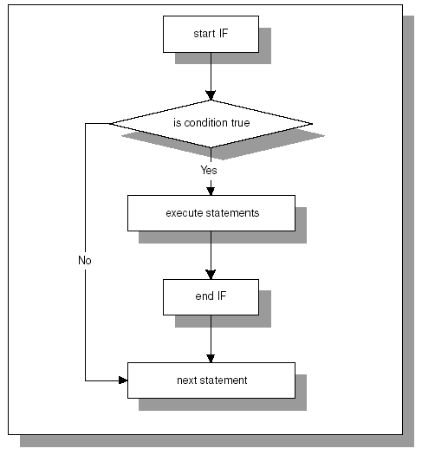

Slide 56
IF-THEN STATEMENTS
When an IF-THEN statement is executed, a condition is evaluated to either TRUE or FALSE.
If the condition evaluates to TRUE, control is passed to the first executable statement of the IF-THEN construct.
If the condition evaluates to FALSE, the control is passed to the first executable statement after the END IF statement.

Slide 57
Example
DECLARE
v_num1 NUMBER := 5;
v_num2 NUMBER := 3;
v_temp NUMBER;
BEGIN
-- if v_num1 is greater than v_num2 rearrange their values
IF v_num1 > v_num2
THEN
v_temp := v_num1;
v_num1 := v_num2;
v_num2 := v_temp;
END IF;
-- display the values of v_num1 and v_num2
DBMS_OUTPUT.PUT_LINE('v_num1 = '||v_num1);
DBMS_OUTPUT.PUT_LINE('v_num2 = '||v_num2);
END;

Slide 58
IF-THEN-ELSE STATEMENT
An IF-THEN statement specifies the sequence of statements to execute only if the condition evaluates to TRUE.
When this condition evaluates to FALSE, there is no special action to take except to proceed with execution of the program.
An IF-THEN-ELSE statement enables you to specify two groups of statements.
One group of statements is executed when the condition evaluates to TRUE.
Another group of statements is executed when the condition evaluates to FALSE.

Slide 59
IF-THEN-ELSE STATEMENT
IF CONDITION
THEN
STATEMENT 1;
ELSE
STATEMENT 2;
END IF;
STATEMENT 3;
When CONDITION evaluates to TRUE, control is passed to STATEMENT 1;
When CONDITION evaluates to FALSE, control is passed to STATEMENT 2.
After the IF-THEN-ELSE construct has completed, STATEMENT 3 is executed.

Slide 60
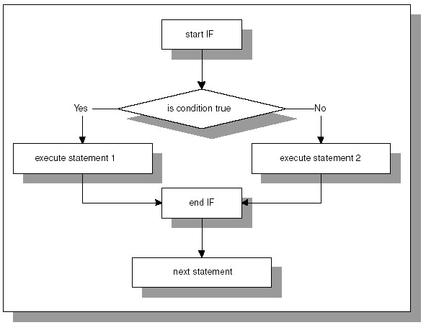
IF-THEN-ELSE STATEMENT

Slide 61
Example
DECLARE
v_num NUMBER := &sv_user_num;
BEGIN
-- test if the number provided by the user is even
IF MOD(v_num,2) = 0
THEN
DBMS_OUTPUT.PUT_LINE(v_num||' is even number');
ELSE
DBMS_OUTPUT.PUT_LINE(v_num||' is odd number');
END IF;
DBMS_OUTPUT.PUT_LINE('Done…');
END;

Slide 62
NULL CONDITION
In some cases, a condition used in an IF statement can be evaluated to NULL instead of TRUE or FALSE.
For the IF-THEN construct, the statements will not be executed if an associated condition evaluates to NULL.
Next, control will be passed to the first executable statement after END IF.
For the IF-THEN-ELSE construct, the statements specified after the keyword ELSE will be executed if an associated condition evaluates to NULL.

Slide 63
Example
DECLARE
v_num1 NUMBER := 0;
v_num2 NUMBER;
BEGIN
IF v_num1 = v_num2
THEN
DBMS_OUTPUT.PUT_LINE('v_num1 = v_num2');
ELSE
DBMS_OUTPUT.PUT_LINE('v_num1 != v_num2');
END IF;
END;

Slide 64
output:
v_num1 != v_num2
PL/SQL procedure successfully completed.
The condition v_num1 = v_num2 is evaluated to NULL because a value is not assigned to the variable v_num2.
Therefore, variable v_num2 is NULL.

Slide 65
ELSIF STATEMENTS
An ELSIF statement has the following structure:
IF CONDITION 1
THEN
STATEMENT 1;
ELSIF CONDITION 2
THEN
STATEMENT 2;
ELSIF CONDITION 3
THEN
STATEMENT 3;
…
ELSE
STATEMENT N;
END IF;

Slide 66
ELSIF STATEMENTS
The reserved word IF marks the beginning of an ELSIF construct.
The words CONDITION 1 through CONDITION N are a sequence of the conditions that evaluate to TRUE or FALSE.
These conditions are mutually exclusive. In other words, if CONDITION 1 evaluates to TRUE, STATEMENT1 is executed, and control is passed to the first executable statement after the reserved phrase END IF. The rest of the ELSIF construct is ignored.

Slide 67
ELSIF STATEMENTS
When CONDITION 1 evaluates to FALSE, the control is passed to the ELSIF part and CONDITION 2 is evaluated, and so forth.
If none of the specified conditions yield TRUE, the control is passed to the ELSE part of the ELSIF construct.
An ELSIF statement can contain any number of ELSIF clauses.

Slide 68
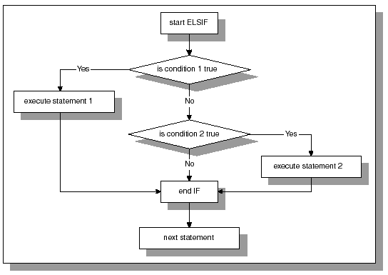
ELSIF STATEMENTS

Slide 69
Example
DECLARE
v_num NUMBER := &sv_num;
BEGIN
IF v_num < 0
THEN
DBMS_OUTPUT.PUT_LINE (v_num||‘ is a negative number’);
ELSIF v_num = 0
THEN
DBMS_OUTPUT.PUT_LINE (v_num ||‘ is equal to zero’);
ELSE
DBMS_OUTPUT.PUT_LINE (v_num||‘ is a positive number’);
END IF;
END;

Slide 70
Assume the value of v_num equals 5 at runtime.
Output
Enter value for sv_num: 5
old 2: v_num NUMBER := &sv_num;
new 2: v_num NUMBER := 5;
5 is a positive number
PL/SQL procedure successfully completed.

Slide 71
ELSIF STATEMENTS
When using an ELSIF construct, it is not necessary to specify what action should be taken if none of the conditions evaluate to TRUE.
In other words, an ELSE clause is not required in the ELSIF construct.
Consider the following example:

Slide 72
Example
DECLARE
v_num NUMBER := &sv_num;
BEGIN
IF v_num < 0
THEN
DBMS_OUTPUT.PUT_LINE (v_num||' is a negative number');
ELSIF v_num > 0
THEN
DBMS_OUTPUT.PUT_LINE (v_num||' is a positive number');
END IF;
DBMS_OUTPUT.PUT_LINE ('Done…');
END;

Slide 73
NESTED IF STATEMENTS
You have encountered different types of conditional controls: IF-THEN statement, IF-THEN-ELSE statement, and ELSIF statement.
These types of conditional controls can be nested inside of another—for example, an IF statement can be nested inside an ELSIF and vice versa.

Slide 74
Example
DECLARE
v_num1 NUMBER := &sv_num1;
v_num2 NUMBER := &sv_num2;
v_total NUMBER;
BEGIN
IF v_num1 > v_num2
THEN
DBMS_OUTPUT.PUT_LINE('IF part of the outer IF');
v_total := v_num1 - v_num2;
ELSE
DBMS_OUTPUT.PUT_LINE('ELSE part of the outer IF');
v_total := v_num1 + v_num2;

Slide 75
Example contd.
IF v_total < 0
THEN
DBMS_OUTPUT.PUT_LINE('Inner IF');
v_total := v_total * (-1);
END IF;
END IF;
DBMS_OUTPUT.PUT_LINE('v_total = '||v_total);
END;

Slide 76
Example explained
The IF-THEN-ELSE statement is called an outer IF statement because it encompasses the IF-THEN statement.
The IF-THEN statement is called an inner IF statement because it is enclosed by the body of the IF-THEN-ELSE statement.
Assume that the value for v_num1 and v_num2 are –4 and 3 respectively.
First, the condition v_num1 > v_num2 of the outer IF statement is evaluated. Since –4 is not greater than 3, the ELSE part of the outer IF statement is executed.
As a result, the message ELSE part of the outer IF is displayed, and the value of v_total is calculated.

Slide 77
Example explained
Next, the condition v_total < 0 of the inner IF statement is evaluated.
Since that value of v_total is equal –l, the condition yields TRUE, and message Inner IF is displayed.
Next, the value of v_total is calculated again.
This logic is demonstrated by the output produced by the example:

Slide 78
Output
Enter value for sv_num1: -4
old 2: v_num1 NUMBER := &sv_num1;
new 2: v_num1 NUMBER := -4;
Enter value for sv_num2: 3
old 3: v_num2 NUMBER := &sv_num2;
new 3: v_num2 NUMBER := 3;
ELSE part of the outer IF
Inner IF
v_total = 1
PL/SQL procedure successfully completed.

Slide 79
LOGICAL OPERATORS
Logical operators can be used to evaluate a condition as well.
In addition, they allow a programmer to combine multiple conditions into a single condition if there is such a need.

Slide 80
Example
DECLARE
v_letter CHAR(1) := '&sv_letter';
BEGIN
IF (v_letter >= 'A' AND v_letter <= 'Z')
OR (v_letter >= 'a' AND v_letter <= 'z')
THEN
DBMS_OUTPUT.PUT_LINE('This is a letter');
ELSE
DBMS_OUTPUT.PUT_LINE('This is not a letter');
IF v_letter BETWEEN '0' and '9'
THEN

Slide 81
Example contd.
DBMS_OUTPUT.PUT_LINE('This is a number');
ELSE
DBMS_OUTPUT.PUT_LINE('This is not a number');
END IF;
END IF;
END;

Slide 82
Example explained
In the example above, the condition
(v_letter >= 'A' AND v_letter <= 'Z')
OR (v_letter >= 'a' AND v_letter <= 'z')
uses logical operators AND and OR.
There are two conditions
(v_letter >= 'A' AND v_letter <= 'Z')
and
(v_letter >= 'a' AND v_letter <= 'z')
combined into one with the help of the OR operator.

Slide 83
Example explained
It is also important for you to realize the purpose of the parentheses.
In this example, they are used to improve the readability only because the operator AND takes precedence over the operator OR.
When the symbol “?” is entered at runtime, this example produces the following output

Slide 84
Output
Enter value for sv_letter: ?
old 2: v_letter CHAR(1) := '&sv_letter';
new 2: v_letter CHAR(1) := '?';
This is not a letter
This is not a number
PL/SQL procedure successfully completed.

Slide 85
PL/SQL - Basic Loop Statement
Basic loop structure encloses sequence of statements in between the LOOP and END LOOP statements. With each iteration, the sequence of statements is executed and then control resumes at the top of the loop.
Syntax
The syntax of a basic loop in PL/SQL programming language is −
LOOP
Sequence of statements;
END LOOP;
Here, the sequence of statement(s) may be a single statement or a block of statements.
An EXIT statement or an EXIT WHEN statement is required to break the loop.

Slide 86
Example
DECLARE
x number := 10;
BEGIN
LOOP
dbms_output.put_line(x);
x := x + 10;
IF x > 50 THEN
exit;
END IF;
END LOOP;
-- after exit, control resumes here
dbms_output.put_line('After Exit x is: ' || x);
END;
/
Output
10 20 30 40 50
After Exit x is: 60
PL/SQL procedure successfully completed.

Slide 87
You can use the EXIT WHEN statement instead of the EXIT statement −
DECLARE
x number := 10;
BEGIN
LOOP
dbms_output.put_line(x);
x := x + 10;
exit WHEN x > 50;
END LOOP;
-- after exit, control resumes here
dbms_output.put_line('After Exit x is: ' || x);
END;
/
Output
10
20
30
40
50
After Exit x is: 60
PL/SQL procedure successfully completed.

Slide 88
Loops concept provides the following advantage in coding
Reusability of code
Reduced code size
Easy flow of control
Reduced Complexity

Slide 89
Loop Control Statements
Loop control statements are those that actually controls the flow of execution inside the loop. Below is the detailed description about the loop control statements.
CONTINUE
This keyword sends an instruction to the PL/SQL engine that whenever PL/SQL engine encounters this keyword inside the loop, then it will skip the remaining code in the execution block of the code, and next iteration will start immediately. This will be mainly used if the code inside the loop wants to be skipped for certain iteration values.

Slide 90
EXIT / EXIT WHEN
This keyword sends an instruction to the PL/SQL engine that whenever PL/SQL engine encounters this keyword, then it will immediately exit from the current loop.
If the PL/SQL engine encounters the EXIT in nested loops, then it will come out of the loop in which it has been defined, i.e. in a nested loops, giving EXIT in the inner loop will only exit the control from inner loop but not from the outer loop. 'EXIT WHEN' is followed by an expression which gives Boolean result.
If the result is TRUE, then the control will EXIT.

Slide 91
GOTO
This statement will transfer the control to the labeled statement ("GOTO <label> ;").
Transfer of control can be done only within the subprograms.
Transfer of control cannot be done from exception handling part to the execution part
Usage of this statement is not recommended unless there are no other alternatives, as the code-control traceability will be very difficult in the program due to the transfer of control from one part to another part.

Slide 92
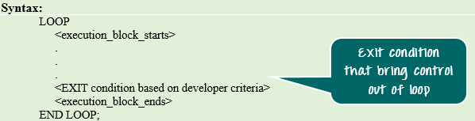
Basic Loop Statement

Slide 93
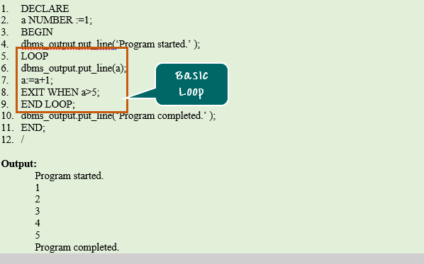

Slide 94
PL/SQL - FOR LOOP Statement
A FOR LOOP is a repetition control structure that allows you to efficiently write a loop that needs to execute a specific number of times.
Syntax
FOR counter IN initial_value .. final_value
LOOP
sequence_of_statements;
END LOOP;

Slide 95
Following is the flow of control in a For Loop −
The initial step is executed first, and only once. This step allows you to declare and initialize any loop control variables.
Next, the condition, i.e., initial_value .. final_value is evaluated. If it is TRUE, the body of the loop is executed. If it is FALSE, the body of the loop does not execute and the flow of control jumps to the next statement just after the for loop.
After the body of the for loop executes, the value of the counter variable is increased or decreased.
The condition is now evaluated again. If it is TRUE, the loop executes and the process repeats itself (body of loop, then increment step, and then again condition). After the condition becomes FALSE, the FOR-LOOP terminates.

Slide 96
Following are some special characteristics of PL/SQL for loop
The initial_value and final_value of the loop variable or counter can be literals, variables, or expressions but must evaluate to numbers. Otherwise, PL/SQL raises the predefined exception VALUE_ERROR.
The initial_value need not be 1; however, the loop counter increment (or decrement) must be 1.
PL/SQL allows the determination of the loop range dynamically at run time.

Slide 97
Example
DECLARE
a number(2);
BEGIN
FOR a in 10 .. 20
LOOP
dbms_output.put_line('value of a: ' || a);
END LOOP;
END;
/
When the above code is executed at the SQL prompt, it produces the following result −

Slide 98
value of a: 10
value of a: 11
value of a: 12
value of a: 13
value of a: 14
value of a: 15
value of a: 16
value of a: 17
value of a: 18
value of a: 19
value of a: 20
PL/SQL procedure successfully completed.

Slide 99
Reverse FOR LOOP Statement
By default, iteration proceeds from the initial value to the final value, generally upward from the lower bound to the higher bound. You can reverse this order by using the REVERSE keyword.
In such case, iteration proceeds the other way. After each iteration, the loop counter is decremented.
However, you must write the range bounds in ascending (not descending) order.
DECLARE a number(2) ;
BEGIN
FOR a IN REVERSE 10 .. 20
LOOP
dbms_output.put_line('value of a: ' || a);
END LOOP;
END;
/

Slide 100
value of a: 20
value of a: 19
value of a: 18
value of a: 17
value of a: 16
value of a: 15
value of a: 14
value of a: 13
value of a: 12
value of a: 11
value of a: 10
PL/SQL procedure successfully completed.

Slide 101
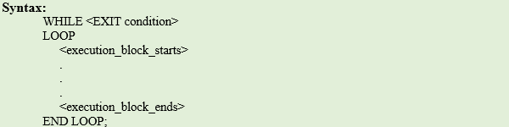
While Loop

Slide 102
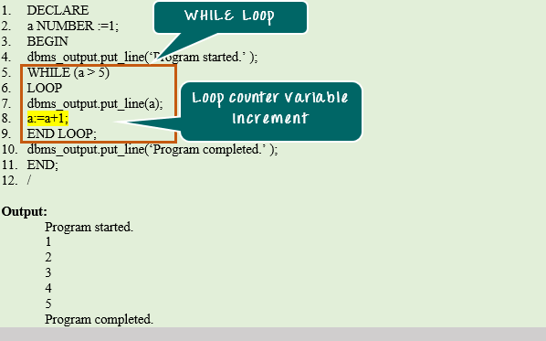

Slide 103
PL/SQL - Exceptions
An exception is an error condition during a program execution.
PL/SQL supports programmers to catch such conditions using EXCEPTION block in the program and an appropriate action is taken against the error condition.
There are two types of exceptions −
System-defined exceptions
User-defined exceptions

Slide 104
Syntax for Exception Handling
The general syntax for exception handling is as follows. Here you can list down as many exceptions as you can handle.
The default exception will be handled using WHEN others THEN −
DECLARE
<declarations section>
BEGIN
<executable command(s)>
EXCEPTION
<exception handling goes here >
WHEN exception1 THEN
exception1-handling-statements
WHEN exception2 THEN
exception2-handling-statements
WHEN exception3 THEN
exception3-handling-statements ........
WHEN others THEN
exception3-handling-statements
END;

Slide 105
DECLARE
c_id customers.id%type := 8;
c_name customers.name%type;
c_addr customers.address%type;
BEGIN
SELECT name, address INTO c_name, c_addr
FROM customers WHERE id = c_id;
DBMS_OUTPUT.PUT_LINE ('Name: '|| c_name);
DBMS_OUTPUT.PUT_LINE ('Address: ' || c_addr);
EXCEPTION WHEN no_data_found THEN
dbms_output.put_line('No such customer!');
WHEN others THEN dbms_output.put_line('Error!');
END;
/
No such customer!
PL/SQL procedure successfully completed.

Slide 106
Raising Exceptions
Exceptions are raised by the database server automatically whenever there is any internal database error, but exceptions can be raised explicitly by the programmer by using the command RAISE.
Syntax for raising an exception −
DECLARE
exception_name EXCEPTION;
BEGIN
IF condition THEN
RAISE exception_name;
END IF;
EXCEPTION
WHEN exception_name
THEN
statement;
END;

Slide 107
User-defined Exceptions
PL/SQL allows you to define your own exceptions according to the need of your program.
A user-defined exception must be declared and then raised explicitly, using either a RAISE statement or the procedure DBMS_STANDARD.RAISE_APPLICATION_ERROR.
The syntax for declaring an exception is −
DECLARE my-exception EXCEPTION;
Example
The program asks for a customer ID, when the user enters an invalid ID, the exception invalid_id is raised.

Slide 108
DECLARE
c_id customers.id%type := &cc_id;
c_name customers.name%type;
c_addr customers.address%type; -- user defined exception
ex_invalid_id EXCEPTION;
BEGIN
IF c_id <= 0 THEN
RAISE ex_invalid_id;
ELSE
SELECT name, address INTO c_name, c_addr FROM customers
WHERE id = c_id;
DBMS_OUTPUT.PUT_LINE ('Name: '|| c_name); DBMS_OUTPUT.PUT_LINE ('Address: ' || c_addr);
END IF;
EXCEPTION
WHEN ex_invalid_id THEN dbms_output.put_line('ID must be greater than zero!');
WHEN no_data_found THEN dbms_output.put_line('No such customer!');
WHEN others THEN dbms_output.put_line('Error!'); END;
/

Slide 109
Enter value for cc_id: -6 (let's enter a value -6)
old 2: c_id customers.id%type := &cc_id;
new 2: c_id customers.id%type := -6;
ID must be greater than zero!
PL/SQL procedure successfully completed.

Slide 110
Pre-defined Exceptions
PL/SQL provides many pre-defined exceptions, which are executed when any database rule is violated by a program.
For example, the predefined exception NO_DATA_FOUND is raised when a SELECT INTO statement returns no rows.
The following table lists few of the important pre-defined exceptions −

Slide 111
Exception | Oracle Error | SQLCODE | Description
ACCESS_INTO_NULL | 06530 | -6530 | It is raised when a null object is automatically assigned a value.
CASE_NOT_FOUND | 06592 | -6592 | It is raised when none of the choices in the WHEN clause of a CASE statement is selected, and there is no ELSE clause.
COLLECTION_IS_NULL | 06531 | -6531 | It is raised when a program attempts to apply collection methods other than EXISTS to an uninitialized nested table or varray, or the program attempts to assign values to the elements of an uninitialized nested table or varray.
DUP_VAL_ON_INDEX | 00001 | -1 | It is raised when duplicate values are attempted to be stored in a column with unique index.

Slide 112
INVALID_CURSOR | 01001 | -1001 | It is raised when attempts are made to make a cursor operation that is not allowed, such as closing an unopened cursor.
INVALID_NUMBER | 01722 | -1722 | It is raised when the conversion of a character string into a number fails because the string does not represent a valid number.
LOGIN_DENIED | 01017 | -1017 | It is raised when a program attempts to log on to the database with an invalid username or password.
NO_DATA_FOUND | 01403 | +100 | It is raised when a SELECT INTO statement returns no rows.

Slide 113
NOT_LOGGED_ON | 01012 | -1012 | It is raised when a database call is issued without being connected to the database.
PROGRAM_ERROR | 06501 | -6501 | It is raised when PL/SQL has an internal problem.
ROWTYPE_MISMATCH | 06504 | -6504 | It is raised when a cursor fetches value in a variable having incompatible data type.
SELF_IS_NULL | 30625 | -30625 | It is raised when a member method is invoked, but the instance of the object type was not initialized.

Slide 114
STORAGE_ERROR | 06500 | -6500 | It is raised when PL/SQL ran out of memory or memory was corrupted.
TOO_MANY_ROWS | 01422 | -1422 | It is raised when a SELECT INTO statement returns more than one row.
VALUE_ERROR | 06502 | -6502 | It is raised when an arithmetic, conversion, truncation, or sizeconstraint error occurs.
ZERO_DIVIDE | 01476 | 1476 | It is raised when an attempt is made to divide a number by zero.

Slide 115
Stored Procedures & Functions

Slide 116
Stored Procedures & Functions
A subprogram is a program unit/module that performs a particular task. These subprograms are combined to form larger programs. This is basically called the 'Modular design'.
A subprogram can be invoked by another subprogram or program which is called the calling program.
A subprogram can be created −
At the schema level
Inside a package
Inside a PL/SQL block

Slide 117
At the schema level, subprogram is a standalone subprogram.
It is created with the CREATE PROCEDURE or the CREATE FUNCTION statement.
It is stored in the database and can be deleted with the DROP PROCEDURE or DROP FUNCTION statement.
A subprogram created inside a package is a packaged subprogram.
It is stored in the database and can be deleted only when the package is deleted with the DROP PACKAGE statement.

Slide 118
What is a Stored Procedure?
A stored procedure or in simple a proc is a named PL/SQL block which performs one or more specific task.
This is similar to a procedure in other programming languages.
A procedure has a header and a body. The header consists of the name of the procedure and the parameters or variables passed to the procedure.
The body consists of declaration section, execution section and exception section similar to a general PL/SQL Block.

Slide 119
PL/SQL subprograms are named PL/SQL blocks that can be invoked with a set of parameters.
PL/SQL provides two kinds of subprograms −
Functions − These subprograms return a single value; mainly used to compute and return a value.
Procedures − These subprograms do not return a value directly; mainly used to perform an action.

Slide 120
Creating a Procedure
A procedure is created with the CREATE OR REPLACE PROCEDURE statement.
Syntax:-
CREATE [OR REPLACE] PROCEDURE procedure_name
[(parameter_name [IN | OUT | IN OUT] type [, ...])]
{IS | AS}
BEGIN
< procedure_body >
END procedure_name;

Slide 121
Where,
procedure-name specifies the name of the procedure.
[OR REPLACE] option allows the modification of an existing procedure.
The optional parameter list contains name, mode and types of the parameters.
IN represents the value that will be passed from outside and OUT represents the parameter that will be used to return a value outside of the procedure.
procedure-body contains the executable part.
IS keyword is used, when the procedure is nested into some other blocks.
The AS keyword is used instead of the IS keyword for creating a standalone procedure.

Slide 122
Example
The following example creates a simple procedure that displays the string 'Hello World!' on the screen when executed.
CREATE OR REPLACE PROCEDURE greetings
AS
BEGIN
dbms_output.put_line('Hello World!');
END;
When the above code is executed using the SQL prompt, it will produce the following result −
Procedure created.

Slide 123
Executing a Standalone Procedure
A standalone procedure can be called in two ways −
Using the EXECUTE keyword
Calling the name of the procedure from a PL/SQL block
The above procedure named 'greetings' can be called with the EXECUTE keyword as −
EXECUTE greetings;
The above call will display −
Hello World
PL/SQL procedure successfully completed.
The procedure can also be called from another PL/SQL block −
BEGIN
greetings;
END;
/
The above call will display −
Hello World
PL/SQL procedure successfully completed.

Slide 124
Deleting a Standalone Procedure
A standalone procedure is deleted with the DROP PROCEDURE statement.
Syntax for deleting a procedure is −
DROP PROCEDURE procedure-name;
You can drop the greetings procedure by using the following statement −
DROP PROCEDURE greetings;

Slide 125
Procedures: Passing Parameters
We can pass parameters to procedures in three ways. 1) IN-parameters 2) OUT-parameters 3) IN OUT-parameters
A procedure may or may not return any value.

Slide 126
IN
An IN parameter lets you pass a value to the subprogram. It is a read-only parameter. Inside the subprogram, an IN parameter acts like a constant. It cannot be assigned a value. You can pass a constant, initialized variable, or expression as an IN parameter. You can also initialize it to a default value; however, in that case, it is omitted from the subprogram call. It is the default mode of parameter passing. Parameters are passed by reference.
OUT
An OUT parameter returns a value to the calling program. Used for getting output from the subprograms. Inside the subprogram, an OUT parameter acts like a variable. You can change its value and reference the value after assigning it. The actual parameter must be variable and it is passed by value.

Slide 127
IN OUT
An IN OUT parameter passes an initial value to a subprogram and returns an updated value to the caller. It can be assigned a value and the value can be read.
The actual parameter corresponding to an IN OUT formal parameter must be a variable, not a constant or an expression.
Formal parameter must be assigned a value. Actual parameter is passed by value.

Slide 128
DECLARE
a number;
b number;
c number;
PROCEDURE findMin(x IN number, y IN number, z OUT number) IS
BEGIN
IF x < y THEN
z:= x;
ELSE z:= y;
END IF;
END;
BEGIN
a:= 23;
b:= 45;
findMin(a, b, c);
dbms_output.put_line(' Minimum of (23, 45) : ' || c);
END; /

Slide 129
Output:-
Minimum of (23, 45) : 23
PL/SQL procedure successfully completed.

Slide 130
Example:-
This procedure computes the square of value of a passed value. This example shows how we can use the same parameter to accept a value and then return another result.
DECLARE
a number;
PROCEDURE squareNum(x IN OUT number) IS
BEGIN
x := x * x;
END;
BEGIN
a:= 23;
squareNum(a);
dbms_output.put_line(' Square of (23): ' || a);
END;
/
Output
Square of (23): 529
PL/SQL procedure successfully completed.

Slide 131
Methods for Passing Parameters
Actual parameters can be passed in three ways −
Positional notation:-findMin(a, b, c, d);
Named notation:-findMin(x => a, y => b, z => c, m => d);
Mixed notation:-findMin(a, b, c, m => d);

Slide 132
FUNCTIONS

Slide 133
FUNCTIONS
Functions are a type of stored code and are very similar to procedures.
The significant difference is that a function is a PL/SQL block that returns a single value.
Functions can accept one, many, or no parameters, but a function must have a return clause in the executable section of the function.
The datatype of the return value must be declared in the header of the function.
A function has output that needs to be assigned to a variable, or it can be used in a SELECT statement.

Slide 134
The function does not necessarily have to have any parameters, but it must have a RETURN value declared in the header, and it must return values for all the varying possible execution streams.
The RETURN statement does not have to appear as the last line of the main execution section, and there may be more than one RETURN statement (there should be a RETURN statement for each exception).
A function may have IN, OUT, or IN OUT parameters.

Slide 135
FUNCTIONS
A function is a named PL/SQL Block which is similar to a procedure. The major difference between a procedure and a function is, a function must always return a value, but a procedure may or may not return a value.
General Syntax to create a function is
CREATE [OR REPLACE] FUNCTION function_name [(parameter_name [IN | OUT | IN OUT] type [, ...])]
RETURN return_datatype
{IS | AS}
BEGIN
< function_body >
END [function_name];

Slide 136
Where,
function-name specifies the name of the function.
[OR REPLACE] option allows the modification of an existing function.
The optional parameter list contains name, mode and types of the parameters. IN represents the value that will be passed from outside and OUT represents the parameter that will be used to return a value outside of the procedure.
The function must contain a return statement.
The RETURN clause specifies the data type you are going to return from the function.
function-body contains the executable part.
The AS keyword is used instead of the IS keyword for creating a standalone function.

Slide 137
Example
CREATE OR REPLACE FUNCTION totalCustomers RETURN number
IS total number(2) := 0;
BEGIN
SELECT count(*) into total FROM customers;
RETURN total;
END;
/
Output:-
Function created.

Slide 138
Calling a Function
While creating a function, you give a definition of what the function has to do.
To use a function, you will have to call that function to perform the defined task.
When a program calls a function, the program control is transferred to the called function.
A called function performs the defined task and when its return statement is executed or when the last end statement is reached, it returns the program control back to the main program.
To call a function, you simply need to pass the required parameters along with the function name and if the function returns a value, then you can store the returned value.
Following program calls the function totalCustomers from an anonymous block −

Slide 139
DECLARE
c number(2);
BEGIN
c := totalCustomers();
dbms_output.put_line('Total no. of Customers: ' || c);
END;
/
Output:-
Total no. of Customers: 6
PL/SQL procedure successfully completed.
Example:-Declaring, Defining, and Invoking a Simple PL/SQL Function that computes and returns the maximum of two values.

Slide 140
DECLARE
a number;
b number;
c number;
FUNCTION findMax(x IN number, y IN number)
RETURN number
IS
z number;
BEGIN
IF x > y THEN
z:= x;
ELSE Z:= y;
END IF;
RETURN z;
END;
BEGIN
a:= 23;
b:= 45;
c := findMax(a, b);
dbms_output.put_line(' Maximum of (23,45): ' || c);
END;
/
Output:-
Maximum of (23,45): 45
PL/SQL procedure successfully completed.

Slide 141
END

